Slide 1


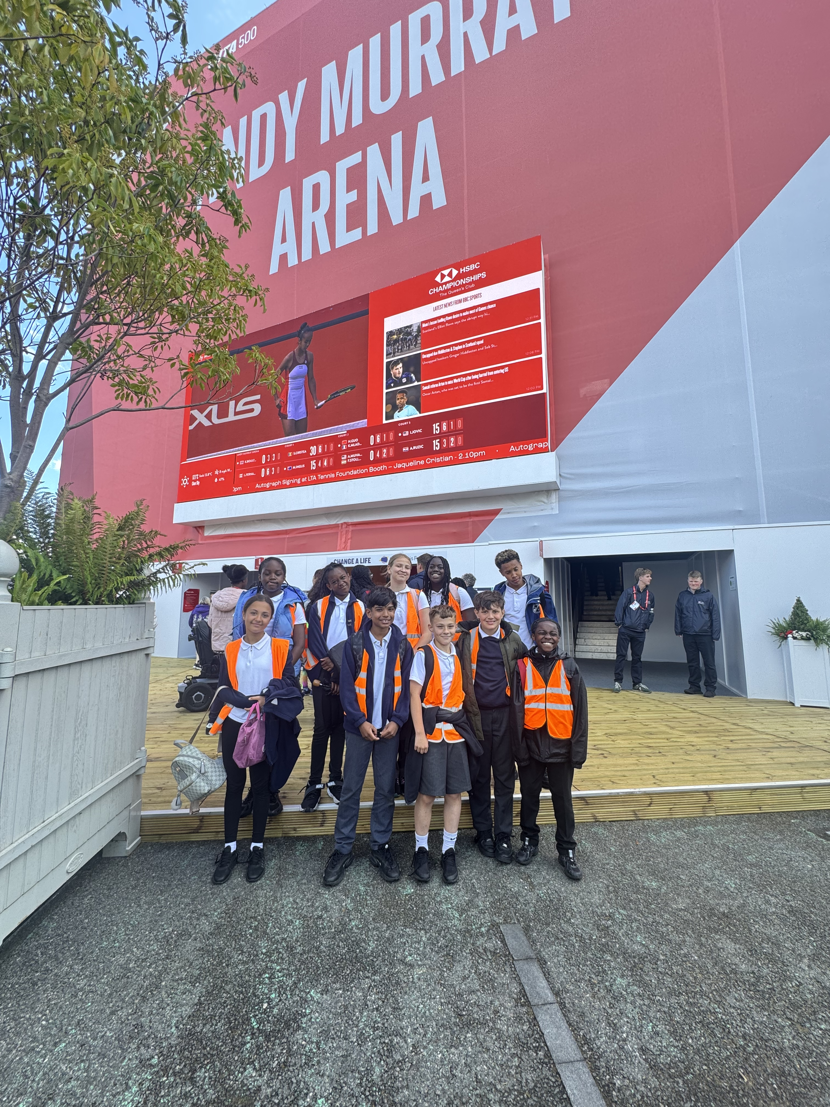

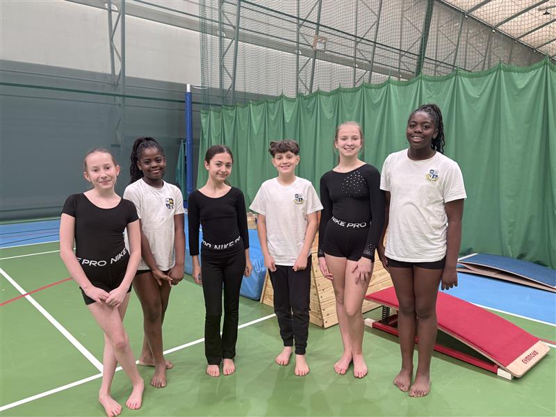
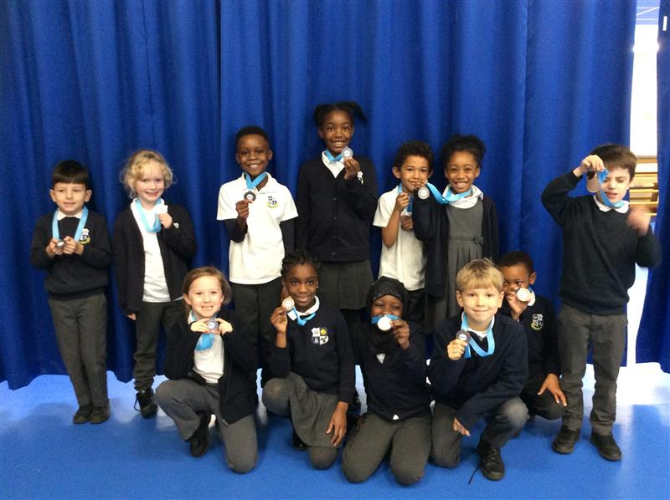


www.quarryhillacademy.org.uk
@QHAThurrock
New equipment purchased for lunch times and for Panathlon Club
10 Year 6 children attened Queens Club for the HSBC Tennis Tournament
150 Minutes of curriculum PE lessons each week
Impact of Primary PE and Sports Premium
External coach from West Ham Foundation to deliver football sessions for Year 5
18 Extra Curriculum Sports Clubs offered across KS1 and KS2
30 extra curricular clubs and activities
£5000 spent on new PE & sport equipment
16 Sports Leaders Selected across Year 6 to run engaging activities at lunchtimes.
34 Events and Competitions entered, including 3 SEN events
72% of pupils take part in extra curricular clubs every week
150 minutes of curriculum PE every week
Internal events and activities ran through the year such as Mini Marathon, World Fitness Day, Sports Day and Prostrike Fundraising Day
Links with local sports clubs for Athletics, Cricket Football and swimming; staff CPD
External coach from Chance to Shine Cricket to deliver Cricket Sessions from Reception - Year 6​

