Slide 1

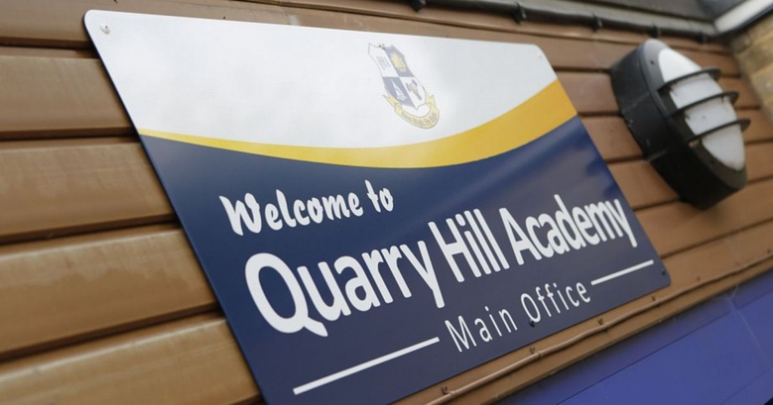
Reception
Induction Meeting
QUARRY HILL ACADEMY
AIM HIGH – FLY HIGH

Slide 2

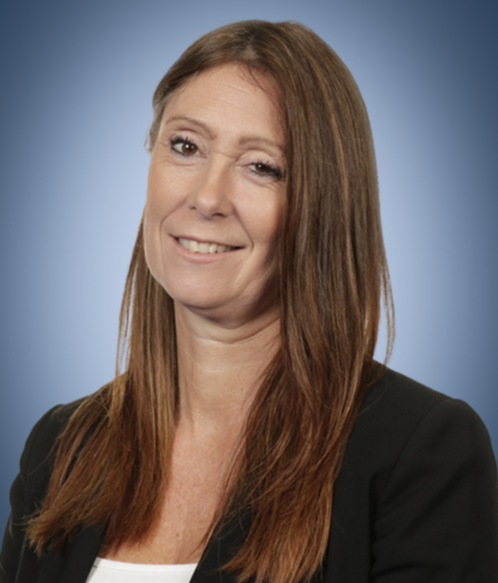

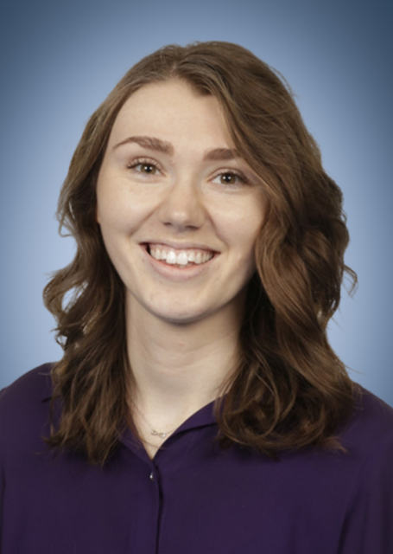
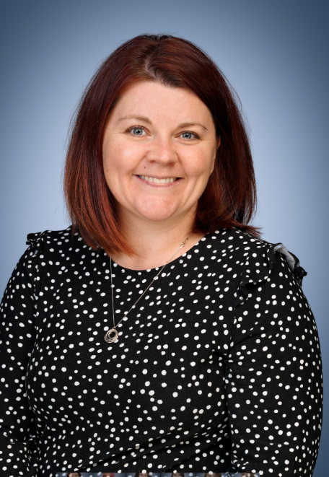
Our leadership team
Mrs Wakeling
Executive Headteacher
Miss Weller
Head of School
Mrs Robinson
Assistant Head Teacher
Mrs Wilson
Assistant Head Teacher

Slide 3
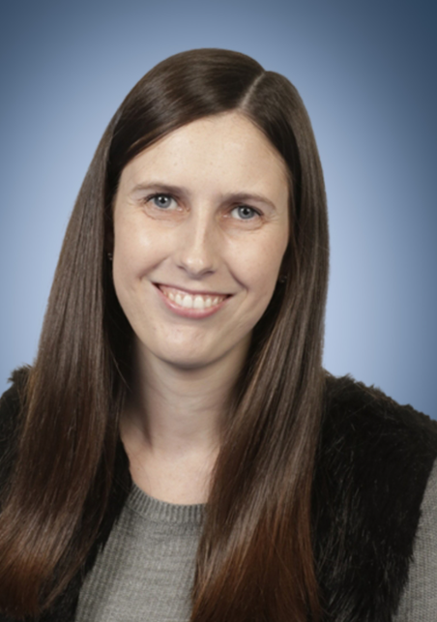
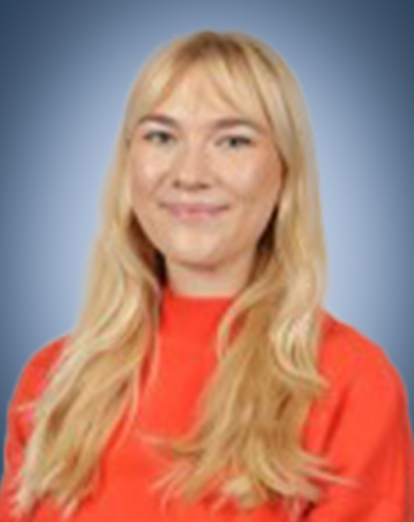
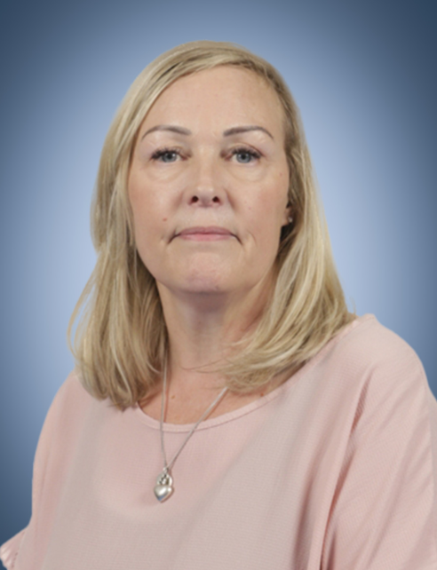
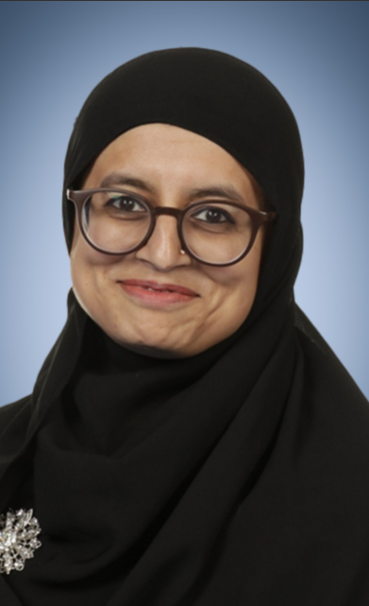
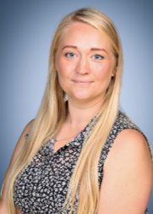
Meet the Reception team
Miss Milbourn
Lead Teacher
Miss Dobson
Class Teacher
Mrs Everett
Mrs Soorty
Miss Sunnucks
Mrs Scott

Slide 4
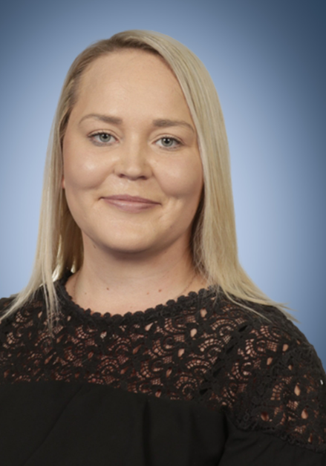
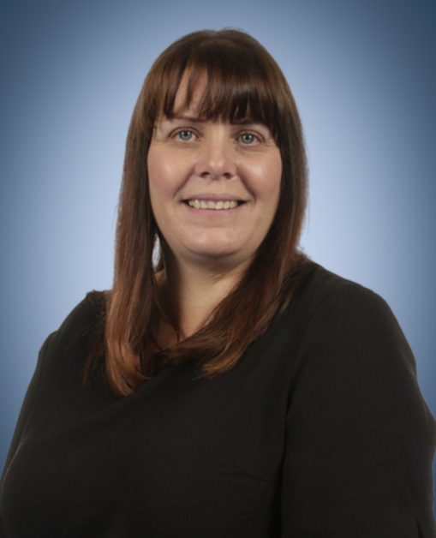
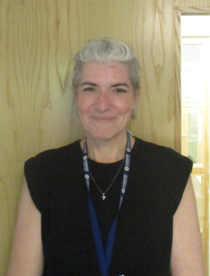
Support for families - team
Miss Childs
SENCo
Mrs Young
Family support worker
Mrs Kitchener
Pupil services support officer

Slide 5
Reception School Day
8:40am Arrival
Phonics
Literacy input
Choosing and group work
12:15pm – 1:05pm LUNCH
Relaxation/Registration
Maths input
Choosing and group work
Songs/Story time
3:15pm Home time
Throughout the week, children will take part in activities to support other areas of the curriculum:
PE/Music/Understanding of the world/Personal, Social and Emotional Development/Creative and Imaginative

Slide 6
Our Learning Approach
Learning through play - at the heart of all we do!
At Quarry Hill we value the importance of opportunities for children to explore, investigate and imagine. It is here that skills are taught, learnt and explored freely.
We also value the importance of preparing for the future. Therefore, we encourage children to experience formal learning opportunities – sitting at tables for group work, learning inputs and through homework.
Partnership with Parents – We value our partnership with parents/carers. We provide opportunities for you to come into school and experience sessions throughout the year, with your child.
We look forward to welcoming you to the following live lessons:
Phonics/ Maths input/ Literacy input
(dates to be confirmed)

Slide 7
Early Years Foundation Stage Profile
Prime Areas
Specific Areas
Communication and Language
Listening, Attention and Understanding
Speaking
Physical Development
Gross motor skills
Fine motor skills
Personal, Social, and Emotional Development
Self – regulation
Managing self
Building relationships
Literacy
Comprehension
Word Reading
Writing
Maths
Number
Numerical patterns
Understanding of the World
Past and Present
People, Culture and Communities
The Natural World
Expressive Arts and Design
Creating with Materials
Being Imaginative and Expressive

Slide 8
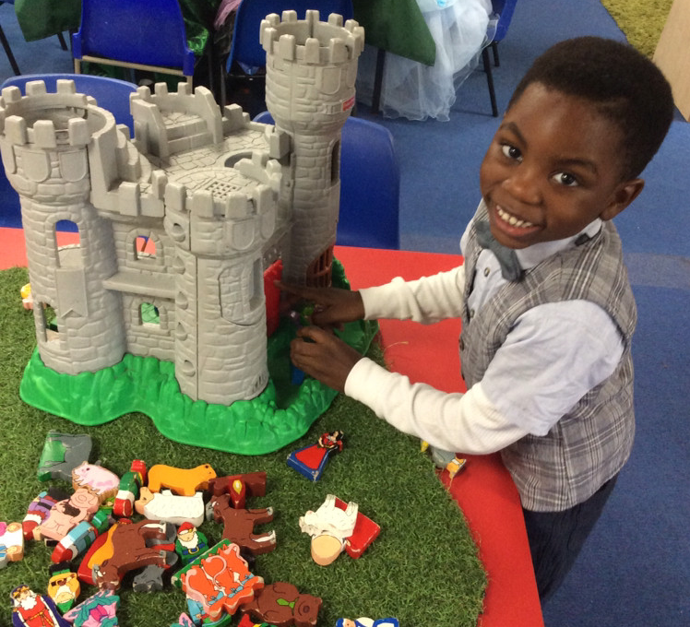
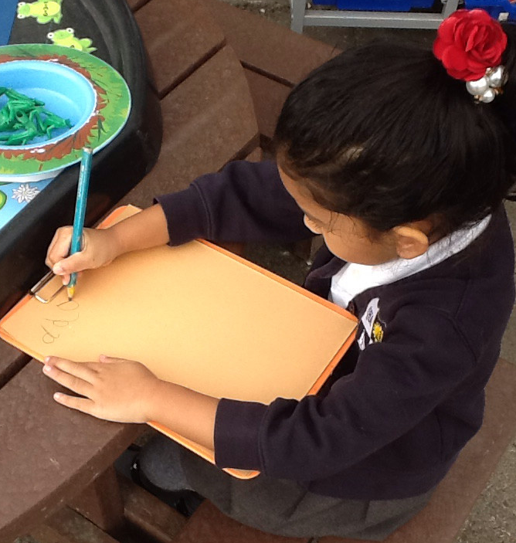
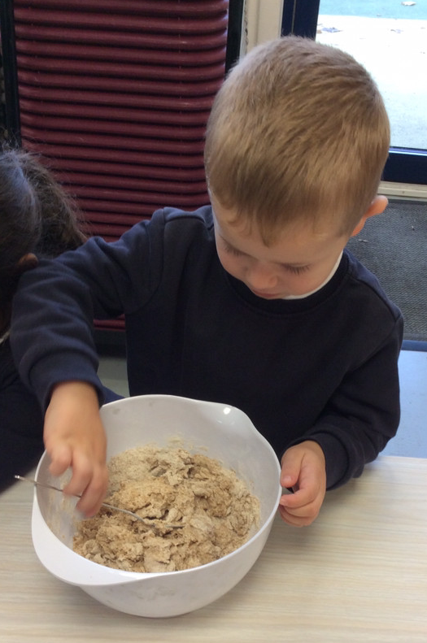
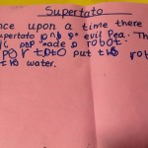
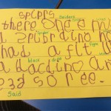
Early Reading and Writing
Writing starts with imagination, story telling and the creation of play experiences with friends.
We then use familiar stories to immerse ourselves, acting out scenes from a book or by making food such as bread from ‘The Little Red Hen’.
We use Read Write Inc. to learn the letters of the alphabet and begin blending and segmenting for reading and writing.
We use ‘Story Scribing’ daily, to begin learning how to write simple sentences, leading to story writing by the end of the year.

Slide 9
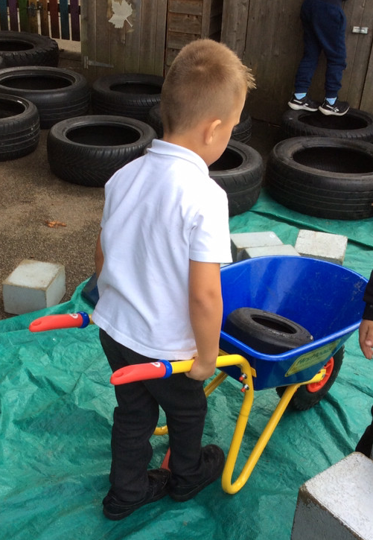
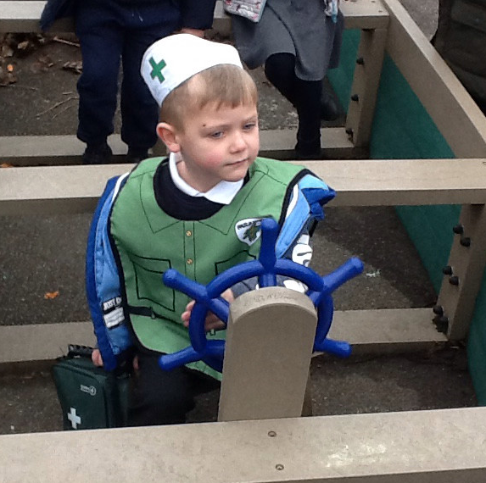
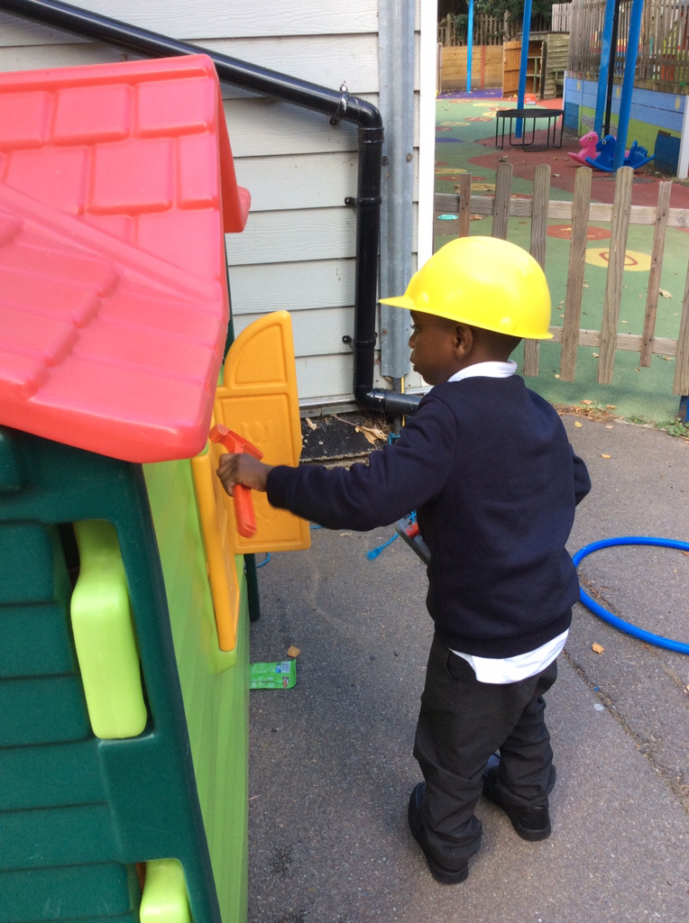
Outdoor Learning
We encourage our pupils to explore and play outside, in all weather conditions! Outdoor Learning is vital to child development - building muscles, independence, imagination and life skills.
We kindly ask parents to send children to school with the following:
Appropriate clothing for all weather conditions e.g., coats, hats, gloves, sun hats etc.
Wellington Boots
Waterproof jacket and trousers
Please ensure they are all clearly labelled.

Slide 10
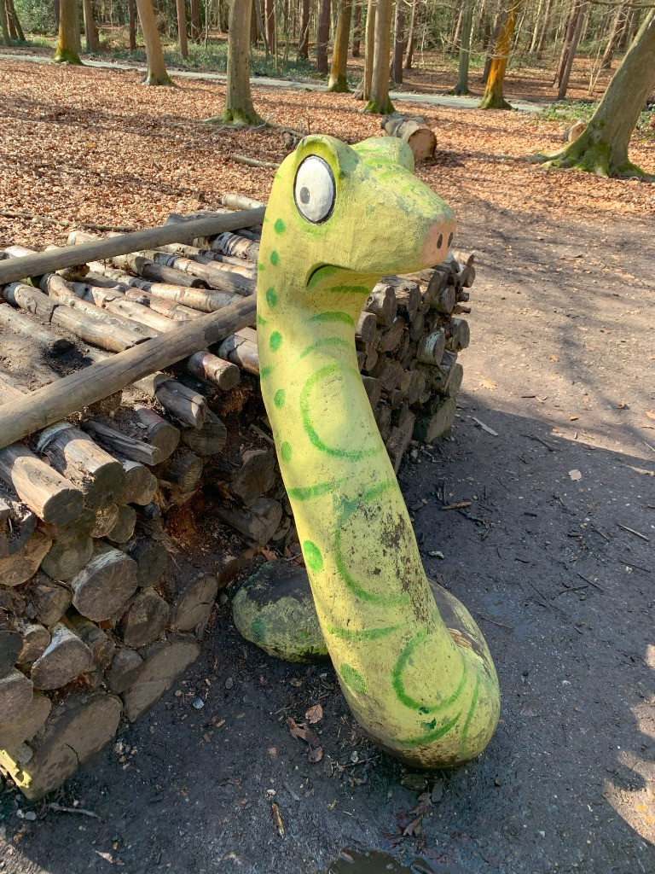
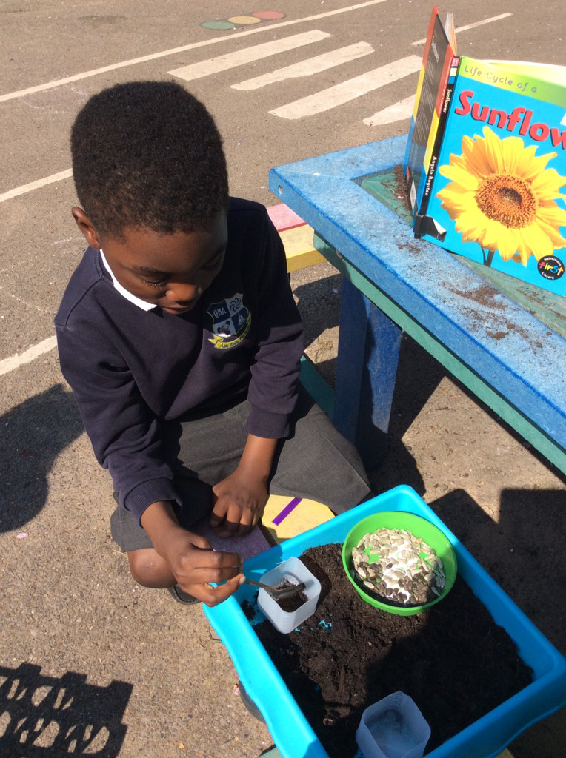
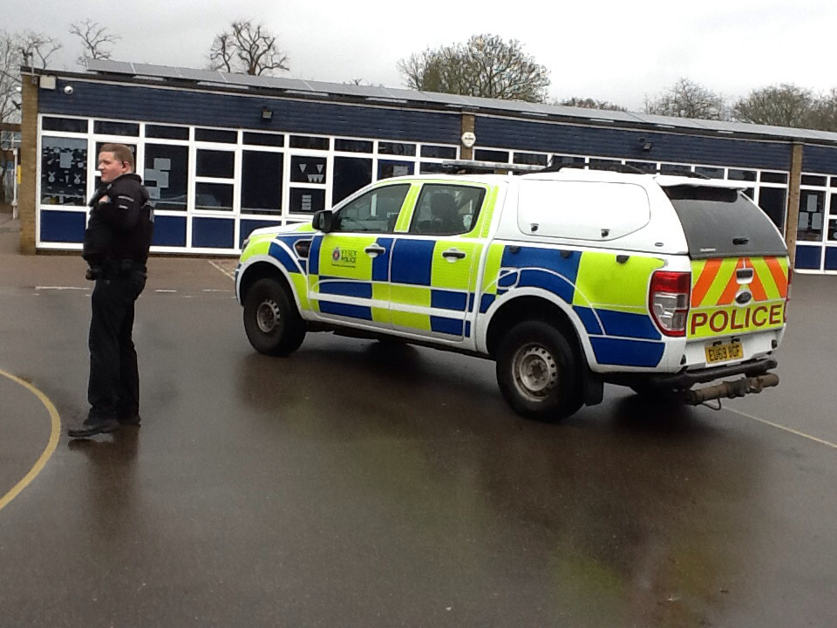
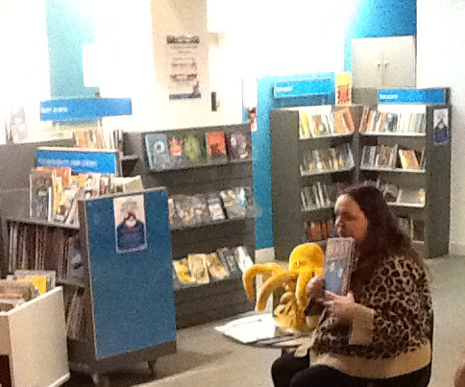
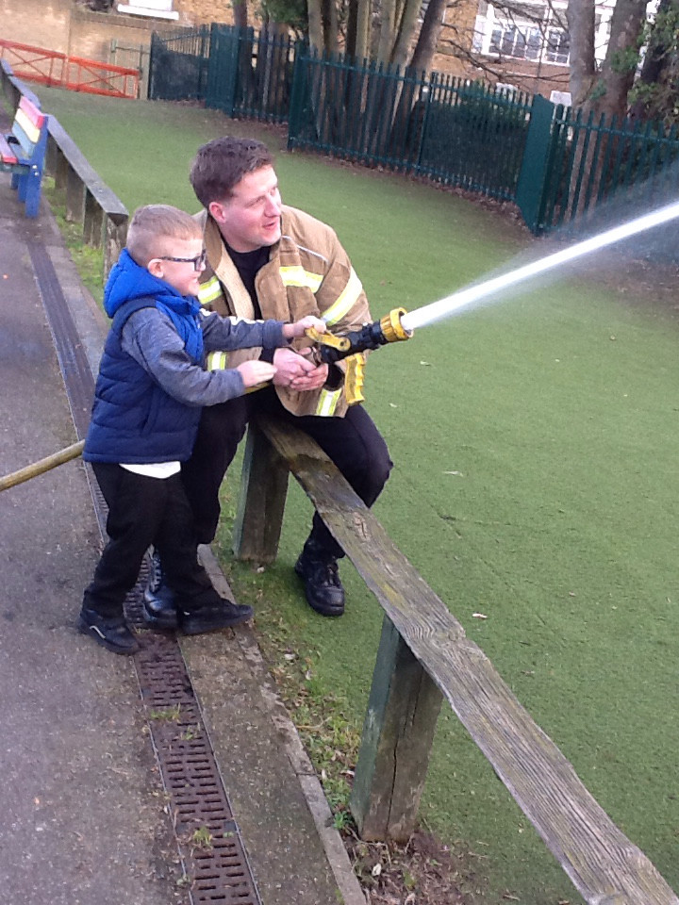
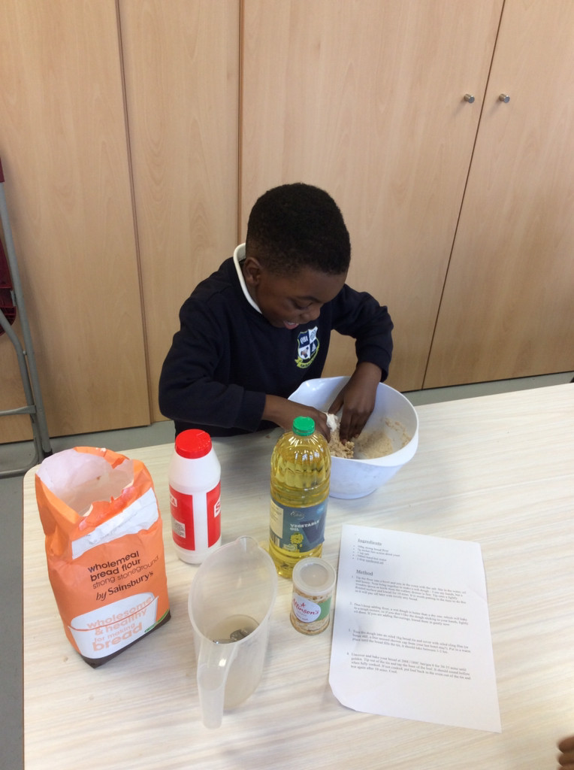
Cultural Capital
To further enhance our curriculum, we strive to give all children opportunities to experience real life events, school trips, enriching experiences that enhance learning and engaging activities that provoke investigation and challenge.
Role play
School trips
Library visits
School visitors
Planting
Cooking
Meditation
High expectations
Dress up days
Emergency services
Sports days
And so much more…

Slide 11
Assessment
Regular assessment of pupil progress will be made throughout your child’s time in Reception.
Assessment is measured by the following:
Working Towards
On Track
To meet age related expectations, children should remain ‘On Track’ to be at the expected level of progress for their age. This is monitored by their key worker, through lots of play and discussion opportunities.
Class teachers will then make the final judgement of both attainment and progress at the end of each half term.
Parents will be regularly updated on their child’s progress and attainment, throughout the year.

Slide 12
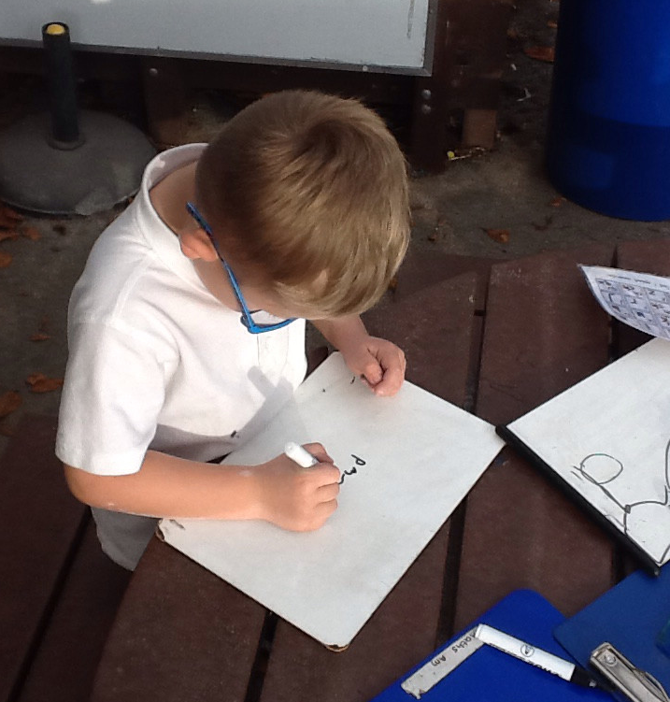
Interventions
In Reception, staff will regularly monitor pupil progress. If there is an area of development that is identified as ‘Working Towards’, the class teacher will organise intervention groups to target these areas.
Children will then be involved in weekly sessions, over a period of 6 weeks, to further support any areas that they are currently requiring support in. These sessions run with fewer children and use games and creative activities to enhance learning.
Regular monitoring through observation will be completed to then support children to become ‘On Track’.

Slide 13






Topics
We use a range of interesting topics to inspire our learning each half term:
Autumn 1 – All About Me
Autumn 2 – Traditional Tales
Spring 1 – People Who Help Us
Spring 2 – Explorers
Summer 1 – Growing
Summer 2 - Splash!

Slide 14



Homework
In partnership with parents:
In order to ensure that children’s learning is continued at home, we ask parents to engage in some homework tasks each week.
Your child will bring home a reading book. We ask that you read with your child each night and write a short comment on their reading journal, which is checked daily.
We also have some “Big questions” to challenge your child. Their responses can be recorded onto our home/school partnership platform – Tapestry.

Slide 15

Tapestry
To document your child’s learning journey, we use the electronic platform – Tapestry
You will be able to access:
Photos and videos of your child’s learning
Observations
Upload pictures and videos from home
Receive regular updates and communication from the teachers
Logins will be given via the email that is given to us. Please ensure your email is clearly written on the letter and upper and lower case letters are correct. You will be given a short period of time to set up your account.
Journals can be downloaded at the end of the school year for parents to keep.
We ask that there is no sharing of photos or videos from this platform onto any social media accounts. This is for parent viewing only.

Slide 16


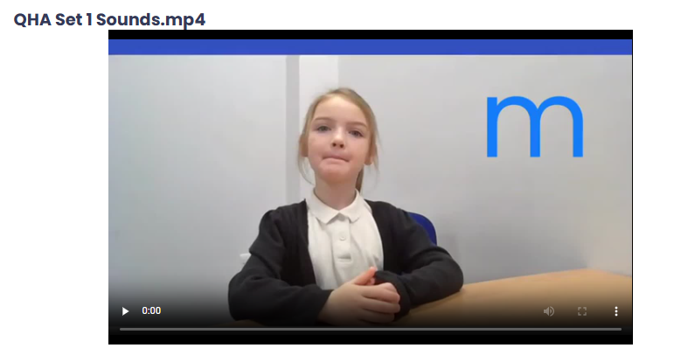
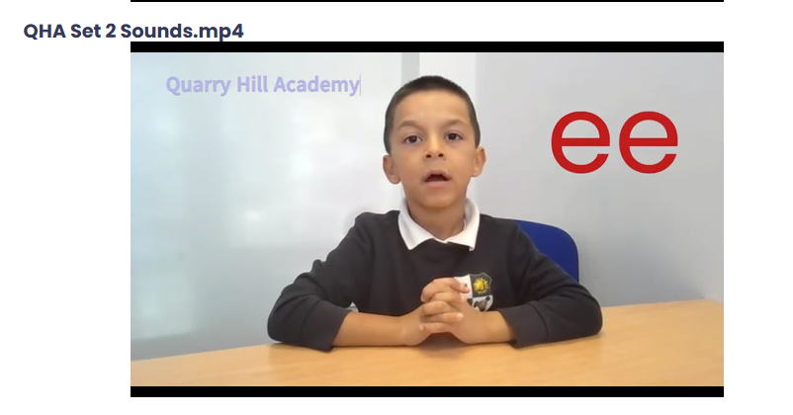

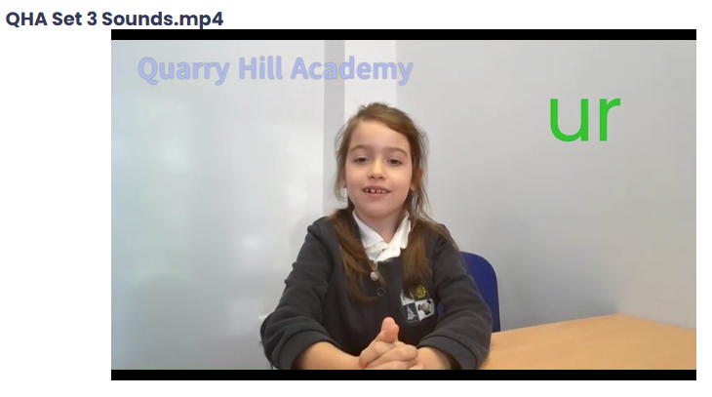
Read Write Inc.
Meet Fred the frog:
Fred helps to encourage children to correctly pronounce initial sounds and to blend/segment when reading.
Fred can “Fred talk” but he can’t blend!
Always refer to segmenting (breaking up a word into sounds) as “Fred talk”
Once children learn to “Fred talk” they can begin to blend. Helping Fred to read.
Fred also supports encouragement of positive behaviour and expectations.
Support for parents can be found on our website.
Quarry Hill Academy - Parent Workshops

Slide 17
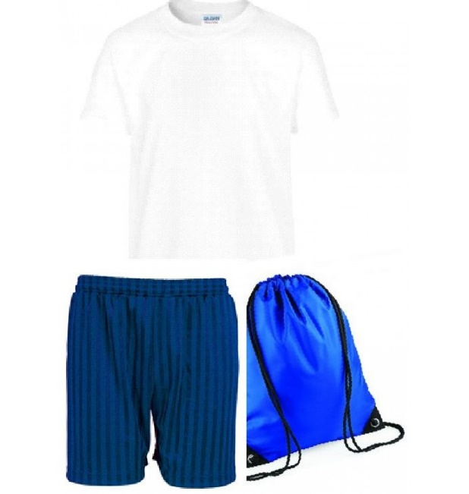
Uniform
Navy sweatshirt or cardigan, with or without QHA logo
Navy fleece, with or without QHA logo
White polo shirt, with or without QHA logo
Grey trousers/ grey skirt / pinafore
Grey summer shorts
Blue checked summer dresses
Plain black shoes (no trainers, black laces only)
Sun cap - with or without QHA logo
Socks or tights - plain grey, black or white
Book bags, with or without QHA logo
White PE shirt, with or without QHA logo
Indoor - Navy PE shorts / Outdoor - tracksuit
Indoor - plimsoles / Outdoor - trainers
PE bag
Quarry Hill Academy (School Uniform) – My Clothing

Slide 18
What does your child need to bring with them, each day?
A book bag
A water bottle (clearly labelled with your child’s name)
Waterproof clothing, for wet weather
Wellington boots (labelled)
Sun hat for warm weather
Snack:
Snack is provided for all EYFS children. Children have a daily choice of milk, their water bottle, toasted bagel and fruit.
Milk is free for all 4 year olds. Once your child reaches 5, parents are able to pay for milk for their child, if they wish to continue having it.

Slide 19
School Dinners
Reception/ KS1 children are entitled to Free school meals up until the end of Year 2.
Menus can be found on our website and leaflets are given at the start of the year.
Your child’s lunch needs to be ordered on their Arbor account for each day.
If you are entitled to any benefits, you may be entitled to “Free School Meals” throughout your child’s schooling. We encourage you to visit the below link if you think you may be eligible, as for every child who is eligible, the school will receive £1550 funding to support pupils.
Why school dinners? – Lunch time is a special time to sit together and enjoy a healthy meal. It gives children an opportunity to learn how to feed themselves, table manners and to be sociable.
There are always three options to choose from and children can view the menu in advance to see what will be on offer each week.

Slide 20
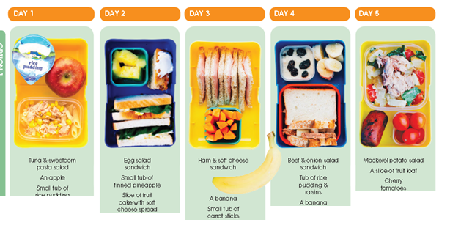
Packed Lunches
However, your child may prefer a home packed lunch. This will need to be selected on your child’s Arbor account.
We ask that when providing your child with a packed lunch, that they are to be healthy (No chocolate, sweets or sugary drinks).
We are a ‘nut free’ school, so please be mindful when packing lunches. (No nuts, chocolate spreads, nut products)

Slide 21
Attendance
Lates:
School opens at 8:40am for Reception pupils and doors will close at 8:50am. Any children arriving after this time will be marked as late.
Absence:
If your child is unwell, please ensure that you call the Bradleigh office to inform them of your child’s absence. It is important to let the school know if your child will not be attending school for each day of their absence.
If your child has had sickness or diarrhoea, we ask that you keep them at home for 48 hours after symptoms arise.

Slide 22
Medical matters
Any medical needs must be shared and evidenced with the Bradleigh office staff prior to your child starting school (Allergies, intolerances, medications etc.)
Pumps and Epi-Pens:
Asthma pumps and Epi-Pens must be kept at school and must be clearly labelled as prescribed by a doctor. These must be handed in at Bradleigh office.
Prescribed medication:
If your child requires medication throughout the day, this must be administered by the parent. Please seek advice from Bradleigh office if you need further guidance for administering medication e.g. Calpol, antibiotics etc.
Please ensure that medical needs are kept up to date with the office to ensure we have the relevant and up to date information on record.

Slide 23
Preparing your child for September
Support your child’s self-help skills by:
Practising independent dressing and undressing
Practising independent cleaning after using the toilet
Practising putting shoes on independently (opt for Velcro to support them)
Ensuring all uniform is labelled clearly
Encourage your child to feed themselves using a knife and fork
Other things you can do to prepare them:
Talk about the daily routine
Show them pictures of the staff
Practise finding their own name and beginning to write their first name
Enjoy reading together
Develop a good sleeping routine
But most importantly, enjoy your holidays and look forward to starting school!

Slide 24
Important dates
Stay and Play sessions - Wednesday 17th June 2026​
Wednesday 24th June 2026
Wednesday 8th July 2026​
Wednesday 15th July 2026
1.45pm-2.30pm
Home visits – Week commencing Monday 29th June 2026
School year begins - Tuesday 1st September 2026
Our term times can be found on our website.
Quarry Hill Academy - Term Dates
Please ensure that holidays are not booked during term time. Any holiday absence must be asked for in advice, through the Bradleigh office.

Slide 25
Thank you!
We Look forward to welcoming you in September
Questions and Answers

